Slide 1
Studying Basketball Through the Lens of Player Tracking Data
Luke Bornn, Daniel Cervon, Alexander Franks, Andrew Miller

Slide 2
12.1 Introduction
In basketball analysis, if we only examine possession outcomes, much of the important strategic aspects of basketball are ignored. For example, a catch-and-shoot player socres a basket because of his teammates’ efforts.
In this chapter, we will utilize the player tracking data by
Describe the tracking data
Highlight the data available for the NBA
Characterize the offensive and defensive playing styles of various players
Use these styles to inform and stablize the inference about the defensive skills.
Look at the notion of decision making.

Slide 3
12.2 Tracking Data
There are two types of technologies to track players, by image processing or sensors. The latter one could improve the accuracy.
The NBA collects the player-tracking data for two-dimensional coordinates of each player and the three-dimensional coordinates of the ball by image processing. In addition to this, the data also consists of annotations for dribbles, passes, shots, turnovers and other actions on the court.
Since the dataset is large, working on the entire data is not feasible. For computational tractability, we explore modeling strategies where the data are naturally partitioned, by dividing the data across players, poessessions, spatial regions, and teams.

Slide 4
12.3 Typifying Players
Traditionally, players position labels (PG, SG, SF, PF, C) are a simplification of a player’s role, but they overlook the variability of player style and kill them within the same position.
This section desribes methods that use player-tracking data to expand our quantification of player roles to better promote apples-to-apples comparisons. We define player roles for players on both offense and defense based on spatial patterns in their play.

Slide 5
12.3.1 Offensive Player Roles
The location of player’s shot attempts is a useful source of information to desribe an offensive player’s role.
These locations offer a sense of how a particular player’s skills are used by an offensive scheme. For example, Tony Parker and Steph Curry are point guards, but their shooting habits and skill sets are quite different. To characterize this difference,we propose to desribe an offensive player in terms of their shot selection. This characterization is also crucial for models that desribe how defensive performance modulates shot selection.
In this section, we develop a method to construct a low-dimensional representation of this point process such that “similar” shooters will be nearby in some low-dimensional space. Shot selection can be stucture as shot types, and a shot type is a cluster of similar shots characterized by a spatially smooth intensity surface over the court. This surface indicates where shots from that cluster tend to come from. Each player’s shooting habits are then represented by a positive linear combination of shot types. Intuitivel, shot types correspond to a soft partitioning of regions of che court, and hence players shooting habits are summarized by a weighting over these regions.

Slide 6
12.3.3 Point Process Decomposition
An intuitive characterization of a player’s shot attempt point process is the spatial rate function. The function integrals over some area of the court, S, describes the rate at which a player shoots from S.
Alternatively, conditioned on a single shot being taken, the spatial rate function can be viewed as an unnormalized probability density over the court that desribes the likelihood of a shot coming from a particular location.
Our goal is to build a model for an individual player’s spatial rate function. Our modeling approach describes each player’s rate function as a positively scaled sum of canonical basis functions that will define our shot types.

Slide 7
Compute canoncial basis functions
Two-step procedure:
Find a nonparametric estimate of each player-specific intensity surface, modeled as log-Gaussian Cox process (LGCP).
Combine surfaces from all players and through nonnegative matrix factorization (NMF), find a low rank representation that best reconstructs the player-specific surfaces. (This step combines information from all players, yielding rate surfaces that generalize better.)

Slide 8
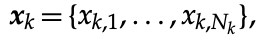
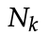
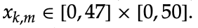
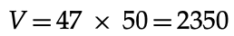
Data
Each player’s set of shot attempts on the offensive half court is denoted as
where is is the number of shots taken by player k, and
We discretize the court into for computational tractability.
Finally, we construct the count matrix

Slide 9
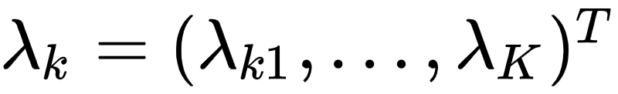
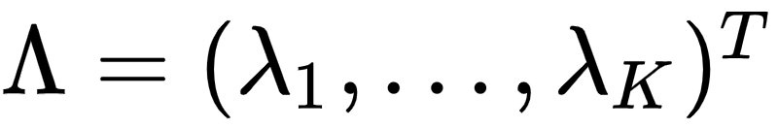
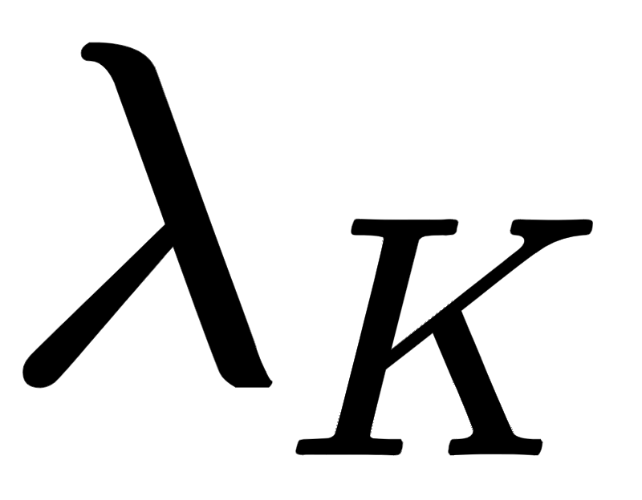
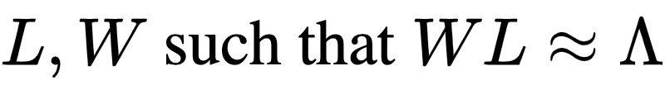

Full Procedure
Construct the count matrix
Fit an intensity surface , for each player k over the discretized court (LGCP)
Construct the data matrix , where has been normalizeed to have unit volume
Find low-rank matrices , constraining all matrices to have nonnegative entries (NMF)
The result of this procedure is a spatial basis that describes canoncial shot type, L and basis loadings for each individual player, .
Given such an interpretable spatial basis, the weights for each player concisely summarize shooting habits in terms of shot types

Slide 10
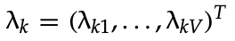
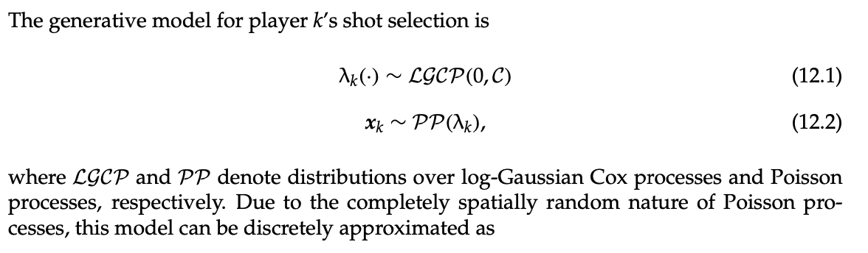
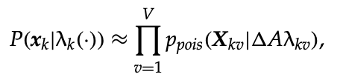
12.3.3 Fitting the LGCPs
Goal: fit an intensity surface for each player k over the court (LGCP).

Slide 11
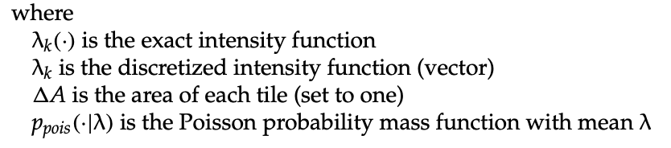
Estimate the model

Slide 12
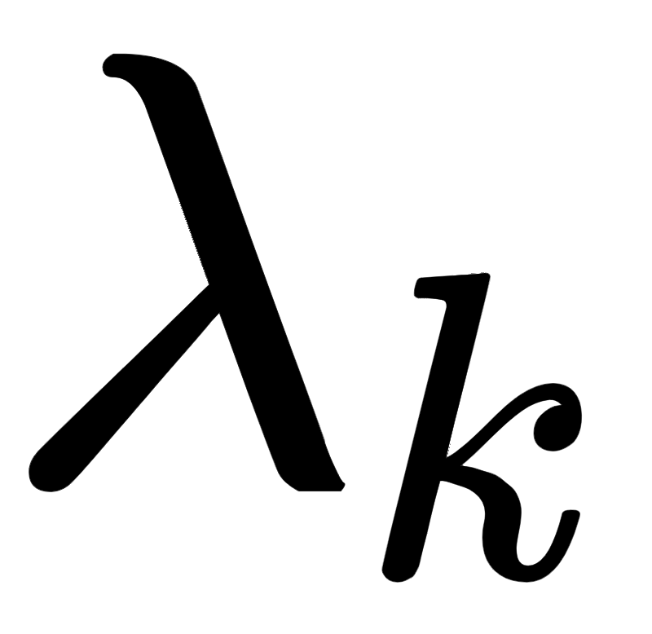
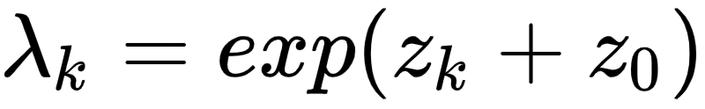
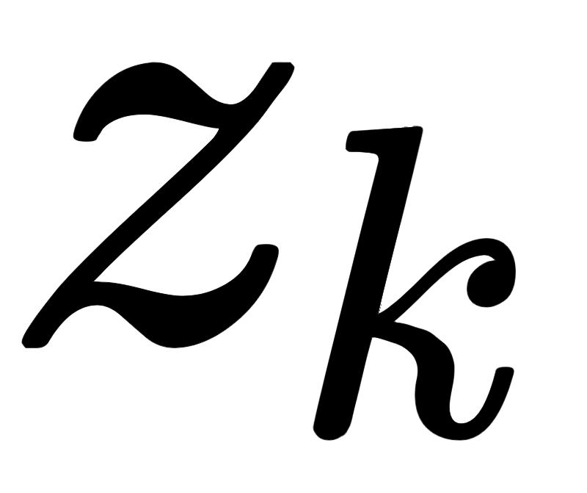
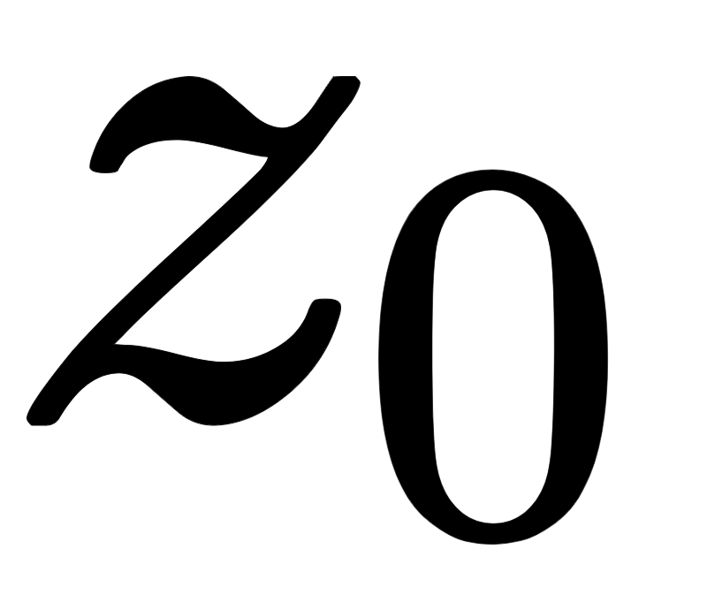
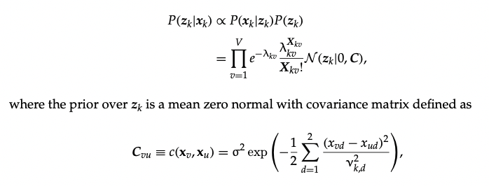
Spatial Dependence Assumption
We assume a spatial dependence on the by letting , where is a Gaussian random field and is an intercept term that parameterizes the mean rate of the Poisson process.
The subsequent posterior has the following form

Slide 13
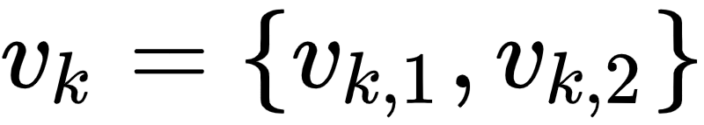
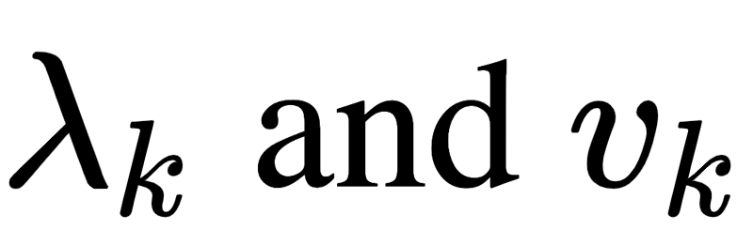
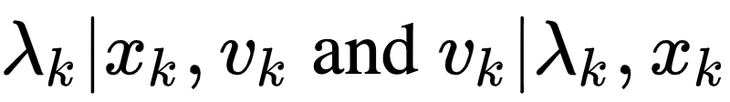
Prior and Posterior Sample
This kernel encodes the prior belief of spatial smoothness. We place a gamma prior over the length scale, , for each individual player.
This gamma prior palaces mass dispersed around 8 ft, indicating the reasonable a priori belief that shooting variation is locally smooth.
We obtain posterior samples of by iteratively sampling using MCMC methods, specifically elliptical slice sampling (Murray et al., 2010).
Question: I don’t understand the meaning of that prior belief.

Slide 14

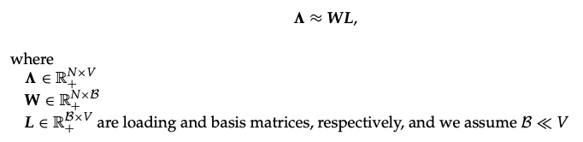
12.3.4 NMF Optimization
Given the collection of player intensity surfaces, we can pool information to find global structure and a low-dimensional space that describes player shooting habits.
NMF (Nonnegative matrix factorization) models a matrix , in our case, the matrix of player-specific intensity functions, as the product of two low-rank matrices.

Slide 15
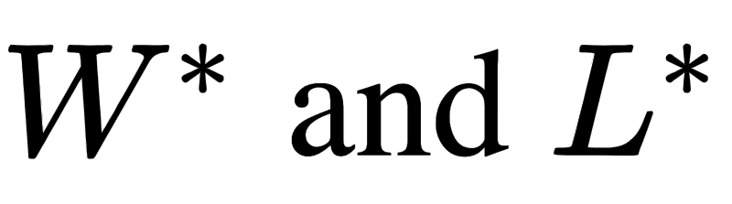

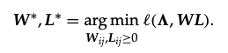
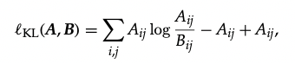
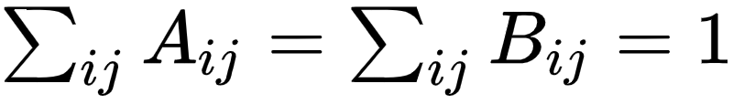
Approximate the matrices
Goal: Find the matrices of best approximation
By: Minimize loss function
Constraint: all elements remain nonnegative, i.e.
Note: Different choices of loss will result in different matrix factorizations. A natural choice is the matrix divergence metrice
which corresponds to KL divergence if A and B are discrete distribution, i,e.
Other possible divergence metrices (i.e. Frobenius) can also be applied.
The optimization problem can be solved using techniques from Lee and Seung (2001) and Brunet et al. (2004).

Slide 16
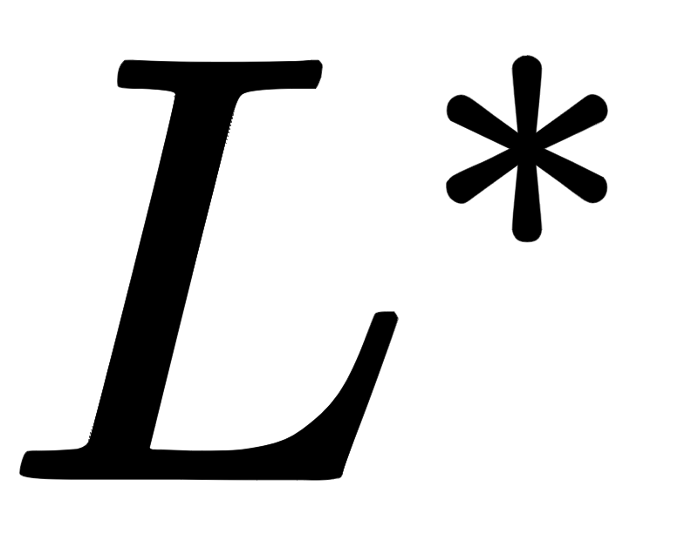
Why NMF?
Due to the positivity constraint, the basis tends to be disjoint, exhibiting a more “parts-based” decomposition than other, less constrained matrix factorization methods such ase PCA.
This is due to the restrictive property of the NMF decomposition that disallows negative bases to cancel out positive bases. In practice, this restriciton eliminates a large swath of “optimal” factorizations with negative basis / weight pairs, leaving a sparser and often more interpretable basis (Lee and Seung, 1999).

Slide 17
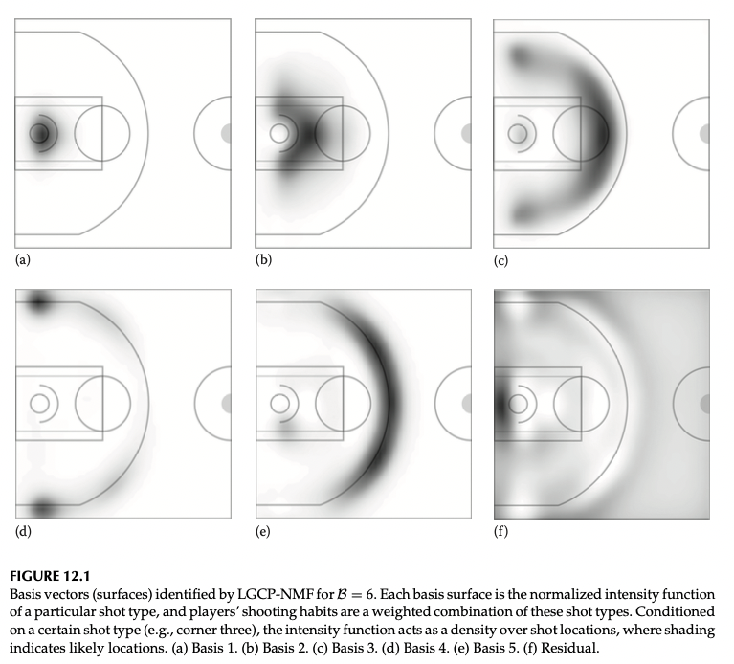

12.3.5 Basis and Player Summaries
The inferred spatial bases are depicted on the right side.
Each player’s shot-selection rate function is modeled as a positive linear combination of these surface.
We also visualize the basis loading (i.e. ) in the following section.
These weights can also be used to specify an informative prior over offensive skill parameters in a possession outcome model.

Slide 18
12.3.6 Defensive Player Roles
We can define defensive roles in a similar way by examining the spatial patterns of the offensive player that each defender guards.
One approach is as follows:
Using the existing basis, count the number of frames a defender’s matchup spends in each basis component and normalize into a vector d. This will categorize defensive players according to the types of offensive players they tend to gurad.

Slide 19
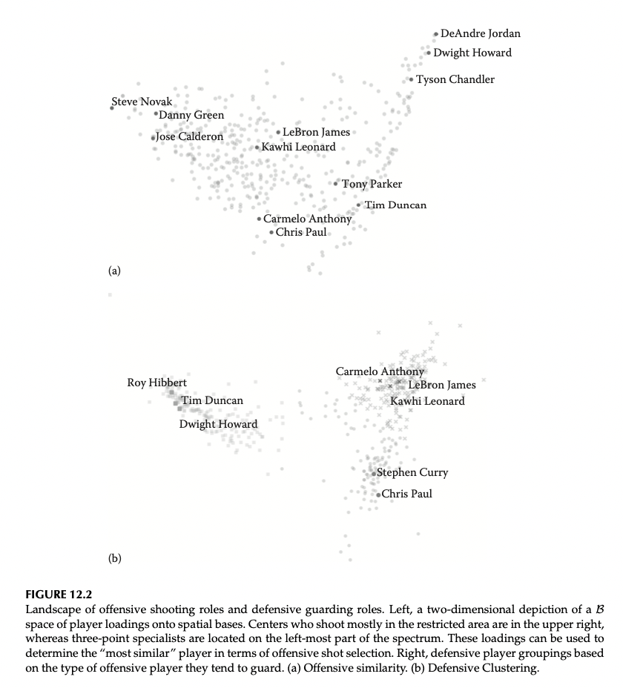
Player weights and Defensive Loadings
The plot above is the basis loadings for each player.
The plot below is the defensive loadings for each player.
The players tend to naturally cluster into three groups, corresponding to “bigs”, “forwards” and “guards”.

Slide 20
12.4 Understanding Defense
Disadvantages of conventional metrics:
integrate over the details of play and thus ignore why and how a player contributes defensively.
Spatial-based metrics:
We can improve the characterization of densive abilities by spatiotemporal information.
The data is rich, but it doesn’t include the information of defensive intent.
Therefore, we can solve how problem, but cannot solve why problem.

Slide 21
Approach to measure defensive impact.
Goal:
quantify a defensive player’s impact on where and who is the shooter, as well as the subsequent probability of the basket being made.
understanding what the player is trying to do before we measure how well a player performs is important to evaluate defensive ability.
How to know the intent?
To do that, identifying who’s guarding whom is not a comprehensive reflection of defensive intent but is still quite useful.
At the starting point, our goal is to estimate how individual defensive matchups evolve over the course of a possession.
Given the matchup information, construct model that assess how well defenders suppress shots and distrupt shots.

Slide 22
12.4.1 Modeling the Evolution of Defensive Matchups
Possible Approach:
Supervised learning.
This requires annotation of defensive strategy for a large training set of possessions.
Train the classifier to identify defensive intent.
However, the annotation is labor intensive and requires domain experts.
Alternative approach:
Estimate man-to-man defensive matchups over the course of a possession using an unsupervised algorithm that does not require labeled examples.

Slide 23

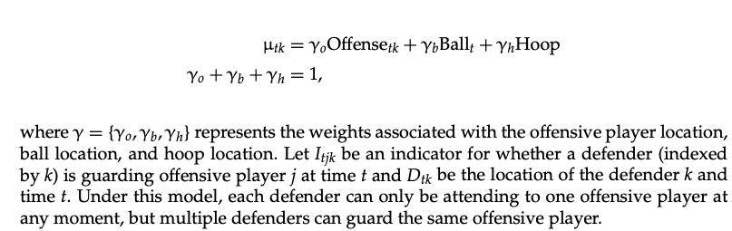
Assumptions about one-on-one defense
Assumption
For all players, the defender’s average location over time lies somewhere in the triangle between the offensive player he is guarding, the ball and the basket
A defender may deviate from this average position due to player or team-specific tendencies, game situations and unobserved covariates.
So, Let be the average defender location for a particular offensive player k at time t.

Slide 24
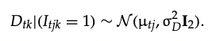
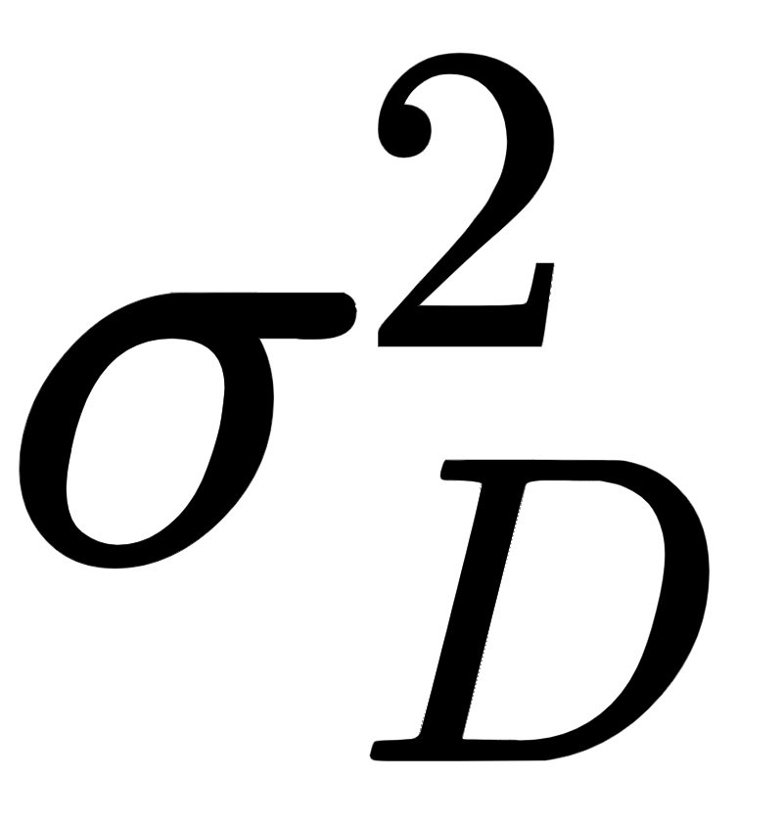
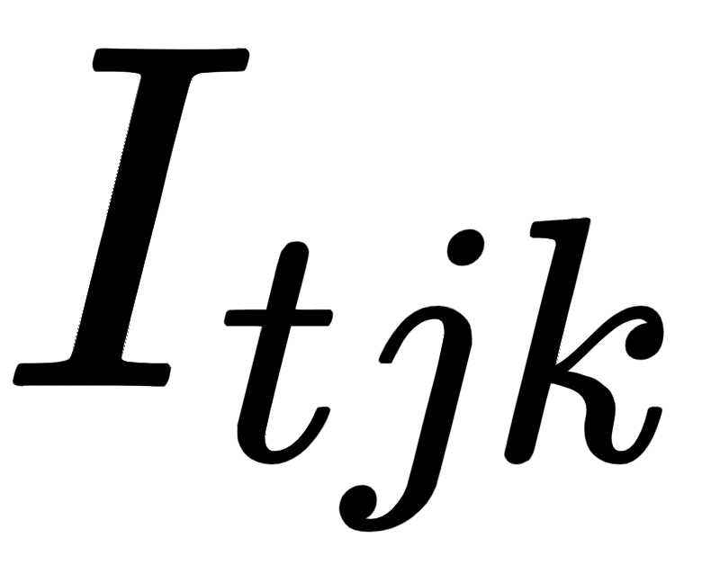
Assumptions about one-on-one defense
Assumption
We further assume that observed location of a defender j guarding offensive player k is normally distributed about the average location.
The parameter represents how much the defensive players typically deviate from the average location over the course of the possession.
Finally, we model the evolution of the defensive assignment, , using HMM.
The hidden states correspond to the offensive player that a defender is guarding.
The HMM enforces smoothness in the evolution of these indicators over time.

Slide 25
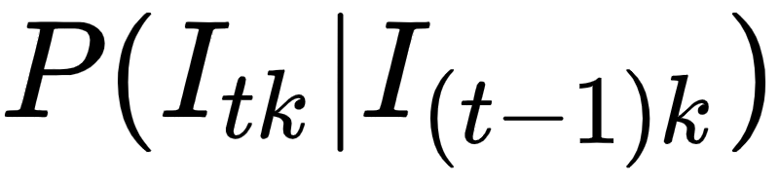
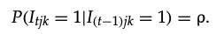
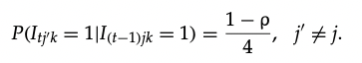
Model Prior Transition Probabilities
We model the prior transition probabilities , corresponding to the probability of a defender switching his assignment from offensive player j to player j’ in any instant.
We assume the prior probability of maintaining the same matchup each iteration is
We also assume the prior probability of a switch to any other offensive player occurs with equal probability

Slide 26
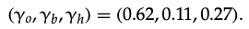
Estimate the Model Parameters
We can estimate the HMM parameters with EM algorithm.
We found that on average, defenders position themselves slightly more than two-thirds of the way between the hoop and the offensive player, hedging slightly toward the ball.
This matches basic basketball intuition that a defender should be close to the offensive player they are guarding, but also each defender needs to attend the location of the ball.
We use this model to infer defensive matchup information for every moment of every game. Next, we illustrate how defensive assignments can be used to construct models fro individual defensive ability.

Slide 28
12.4.2 Characterizing Defensive Ability
With reasonable estimates of “defensive intent”, it is now possible to strucutre the models for how well defenders affect individual offensive play.
We differentiate between a defender’s ability to suppress shots (change shot selection) and distrupt shots (affect the odds that a shot is made).
Method:
Construct joint models for the skills and preferences of offensive players as well as how individual defenders affect htose preferences and skills.
Notes:
Parameter regularization is important, since the individuals only face certain situations a handful time, so the sample sizes can be quite small.
To deal with this, we can exploit similarities between players and pooling information in different ways, and players with similar roles should have similar skill sets and thusparameter values.

Slide 29
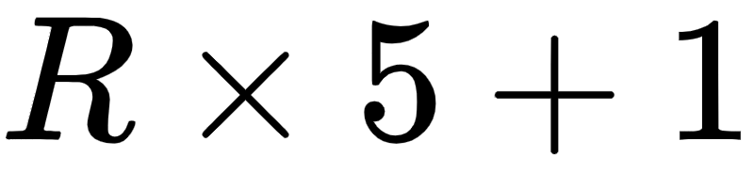
12.4.2.1 Shot Suppression Model
Modeling:
Model shot selection among 5 offensive players in 5 discretized court regions (spatial basis) using a multinomial distribution with logit link function.
There are discrete outcomes for this model, reflecting 5 court regins and five possible shooters, plus one for “no shot” (e.g. turnover).
We model the shot selection as a function of all the shot propensities of all offensive players on the court and the fraction of time within a possession that each offensive players on the court and the fraction of time within a possession that each offensive player is guarded by each defender.

Slide 30
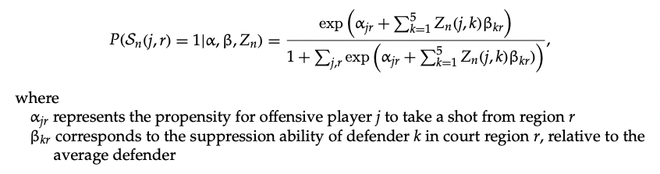
Multinomial Logistic Regression

Slide 31
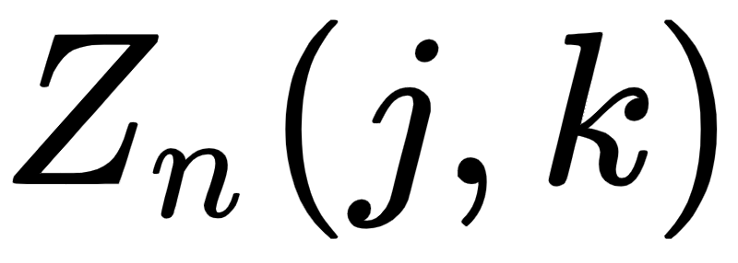
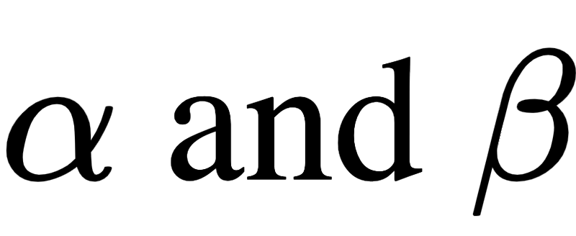
Matchup Time and Prior Selection
Matchup Time:We calculate for each possession using defensive matchup model.
Prior Selection: assume normal distributions of random effect
1. Offense Prior:
The coefficients for each offensive player shrink toward a unique point based on the player’s position in the graph.
2. Defense Prior:
The coefficients for all defenders in the same group shrink to the same value.

Slide 32
Challenges
To fit this multinomial logistic regression over 150,000 possessions, they found the variational inference algorithm introduced by Murphy (2012) to be the most tractable way to estimate the parameters.
The estimates of reflect individual defensive ability to suppress shots in different regions and are discussed in Section 12.4.3 later.

Slide 33
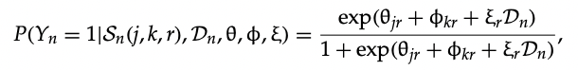
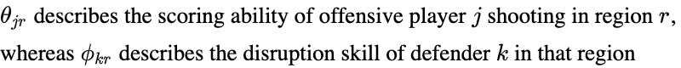
12.4.2.2 Shot Disruption Model
Model: Bayesian logistic Regression
The make/miss probabilities are a function of each shooter’s scoring ability, the distruption ability of the defender, and the defender’s distance to the shooter, then

Slide 34
Prior Selection and Fit
Offensive efficiency parameter:
CAR prior
Defensive disruption parameters:
hierarchical models
Fit
The model is fit by STAN to conduct full Bayesian inference on all model parameters.

Slide 35
12.4.3 Results
The parameters can be used to rank a player’s ability to both suppress and disrupt shots.
Example:
Chris Paul defends relatively few shots in the region close to the basket, yet the players he guards take fewer shots in this area relative to similar defenders.
This suggests that he is good at keeping players from driving toward the rim, even though as a defender he rarely occupies the space under the basket.

Slide 36
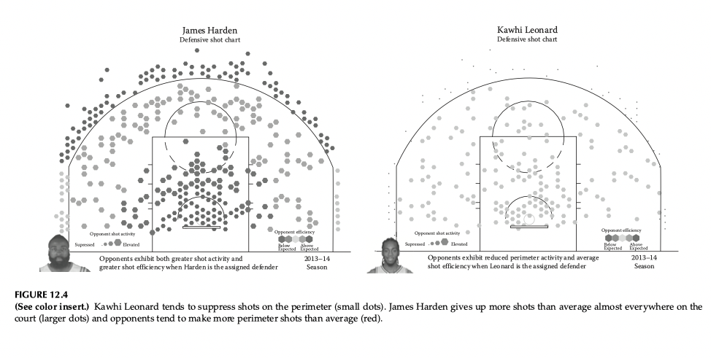

Slide 37
Challenges
There are still many significant challenges in truly understanding defensive competence. “Who’s guarding whom” is only one way to understand intent; without ground-truth team strategy, it is very difficult to know whom a defender is supposed to be guarding or when he is supposed to rotate or switch on defense.
Future work on quantifying defensive ability ought to incorporate defensive schemes into models for both the team and individual skills. This can be accomplished by combing knowledge from basketball experts with more complext models for player interactions.

Slide 38
12.5 Valuing Decision
Decision-making is a key component of a player’s impact in basketball, distinct from the usage and skill in traditional metrics.
In our own work, we quantify decision-making through a quantity called expected possession value (EPV), introduced originally in Cervone et al. (2014).
EPV is the expected number of points the offense will score in a particular possession, given the spatiotemporal history of that possession up to time t.
EPV is calculated using a stochastic process model for basketball possession outcomes. This naturally provides us with counterfactuals for basketball events of interest, which can be used to quantify the value created or destroyed by players’ decisions.

Slide 39
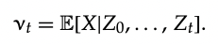
12.5.1 Expected Possession Value
The EPV at time t during a possession provides the offense’s expected point total, given the spatiotemporal evolution of that possession up to time t.
EPV

Slide 40
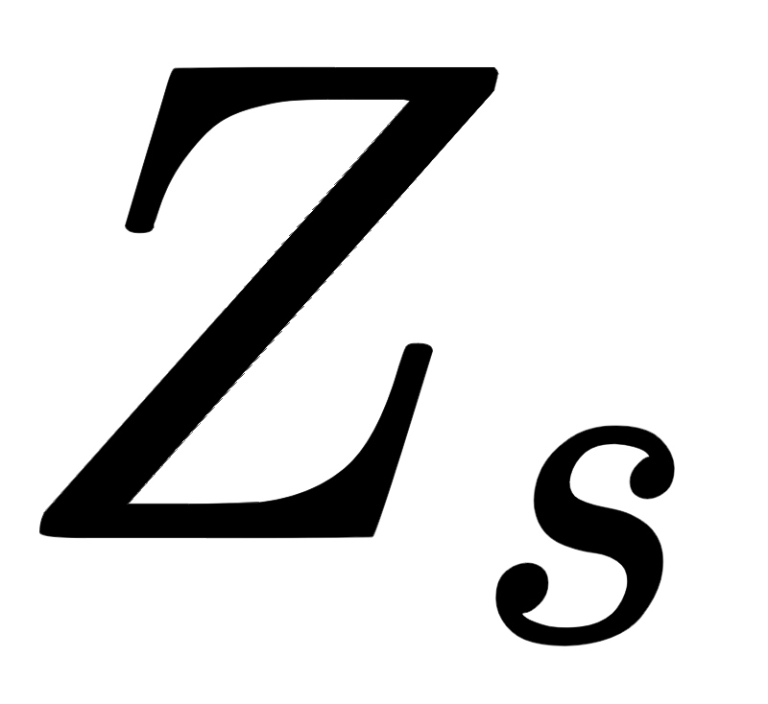
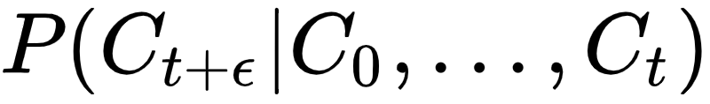
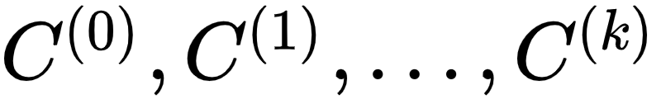
Macro Level Data Processing
The raw spatial data ( ) is the micro level, while we need it to be macro level by the triple:
We assume the model for macro transitions is semi-Markov, i.e. the sequence of new states visited, is a homogeneous Markov chain.

Slide 41
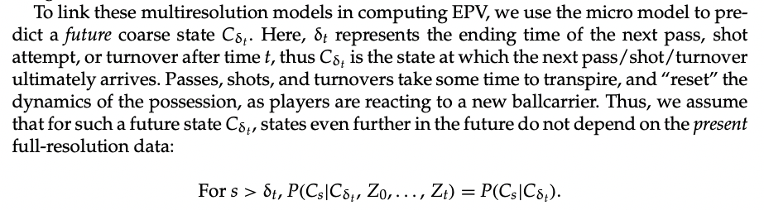
Future States Assumption

Slide 42
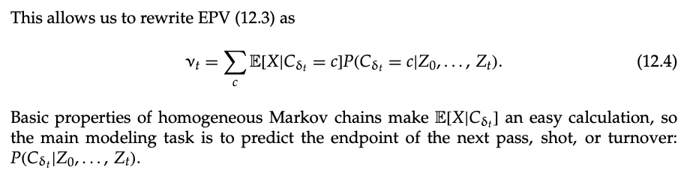
EPV

Slide 43
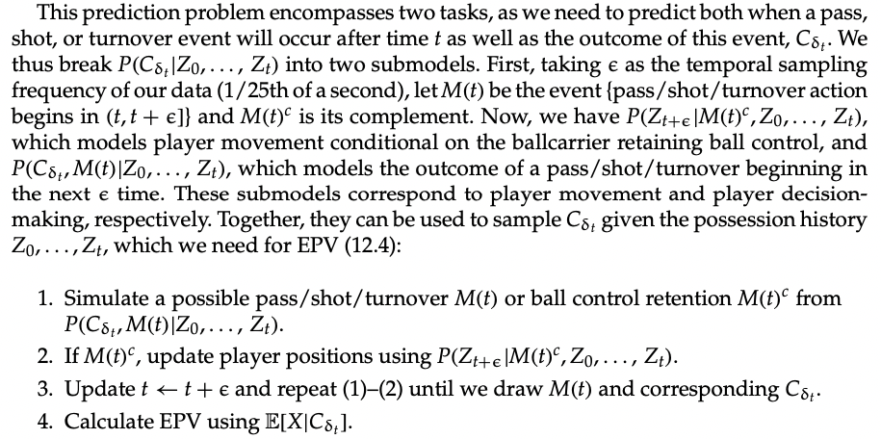
Prediction Problem

Slide 44



12.5.2 Parametric Modeling and Inference
Player Movement
We model as an integrated autoregressive process with spatial innovations.
Then,
Similarly for

Slide 45
Nonstationary spatial behavior
For example, when possessing the ball, players typically accelerate toward the basket when beyond the arc, and decelerate when very close to the basket in order to attempt a shot.
We assume

Slide 46

Spatial Pattern of Acceleration
We estimate the parameters of this offensive model seperately for each player.
We use a different model for defensive players, adapting to include information on who is guarding on whom (see Section 12.4.1).
This ensures that the locations of the offense and defense evolve cohesivel, respecting the spacing inherent in their adversarial roles.

Slide 47
Joint Probability of a pass/shot/turnover occuring
Apart from the movement model, what we need is the joint probability of a pass/shot/turnover occurring in the next time, along with the outcome of that pass/shot/turnover.
This model represents playes’ decision-making tendencies, as we infer spatiotemporal features that influence passing and shooting behavior.

Slide 48

Log-linear models for 7 possible choices

Slide 49


Passing Term

Slide 50

Interpretation

Slide 51


Slide 52

Hierarchical Model Structure

Slide 53
12.5.3 Analyzing Possessions Using EPV
Given estimates of all unknown parameters, EPV can be calculated using the function in order to produce EPV curves that trace the progress of a possession.
Because EPV derives from an interpretable statistical model, at any point in time we can understand how an EPV estimate is realized as a function of the possession history.

Slide 54

Example

Slide 55

Example 2
In Figure 12.8a, we see that EPV derives primarily from Lewis’ passing options, of which LeBron James is the most likely target.
In Figure 12.8b, we see EPV is driven by an 83% chance of a close-range shot attempt from James, which given the lack of rim protection by the defense, has an expected value of 1.5 points.

Slide 56
12.5.4 Derived Metrics
We can also aggregate player events over the course of a season to discover players who consistently create value for the offense through passing, shooting or simply positioning themselves effectively.
Rather than naively aggregating EPV changes to players, we can consider EPV added (EPVA) by a player’s actions and decisions relative to the value of a league average player handling the ball in the same situations.

Slide 57

EPVA
EPVA(l) = summing such differences over all moments where the player possess the ball.

Slide 58
Meaning
Generally, high EPVA players adapt their decision-making pro- cess to the spatiotemporal circumstances confronting them upon gaining possession. They receive the ball in situations suited to their abilities, so that on average they outperform the rest of the league in these circumstances.
Low EPVA players may be skilled; however, their actions simply tend to lead to fewer points than other players given the same options.
EPVA quantifies value players provide through all of their actions and decisions, extending the scope of basketball analytics beyond the box score statistics. However, EPV can also be used to construct metrics related to traditional basketball events, such as shots, passes, rebounds, etc. For instance, by implicitly providing counterfactual possession paths, we can assess the (un)selfishness of shooters across the league.

Slide 59


Slide 60

Shot Satisfaction Metric
For each shot attempt a player takes, we wonder how satisfied the team is with the player ’s decision to shoot—what was the expected value of the shot relative to his most reasonable passing option at the time of the shot?
If for a particular player, the EPV measured at his shot attempts is higher than the EPV conditioned on his possible passes at the same time points, then the team is satisfied with that player’s shoot- ing behavior, as it generally represents the best decision for the team. On the other hand, players with pass options at least as valuable as shots could be labeled “selfish shooters.”

Slide 61

SATIS
While players who mainly attempt three-pointers (e.g., Miller, Korver) and/or close range shots accrue the most satisfaction, players who primarily take mid-range or long-range two- pointers (e.g., Aldridge, Garnett) or poor shooters (e.g., Rubio, Prince) have the least.

Slide 62
Conclusion
We explore the insights of basketball player-tracking data.
It is helpful for understanding of team and individual skill, strategy and performance.
We show that how to understand player types by studying the space, and identify the defensive matchup as well as characterize defensive performance.
Finally, we see how the full-resolution player-tracking data allow us to characterize opportunity and decision-making.

